Slide 1
WATER QUALITY FROM MOBILE CAPTURED AND GOOGLE EARTH IMAGES
Under guidance of
Mr/Dr. Faculty,
Designation,
BIT,
Sathy.
191CS132 & ASWATHY B B
191CS153 & DHANISH K S
192IT233 & SHERINE BENITTA A
191CS139 & BENIGA W H

Slide 2
Abstract
Water excellence in rural regions is tough to display because of loss of connectivity from one-of-a-kind water laboratories. In different regions, location-primarily based totally real-time water excellent statistics series is a tedious task and particularly depending on human intervention .The paper offered here has low-cost battery operated smartphone-based embedded system design to measure different water quality parameters in various remote locations. Developed system measures pH, total dissolved salt (TDS) and temperature of the water samples using sensors .An android application offers analysis
and cloud data storage possibilities. It also provides a facility to analyze water quality data with location information on Google maps for quick judgment and easy understanding.

Slide 3
Problem Statement Addressed
There are areas around us where people are suffering from various diseases mostly caused by water pollution.To avoid this situation we would like to propose a project to check the quality of water using the latest technology

Slide 4
Existing Solution to the Problem Addressed
Most of the water quality measuring project is based on sensors to check the content of purity in the water. Sensors like pH ,TDS .

Slide 5
Proposed Solution to the Problem Addressed
Like I have mentioned in the before slide ,we including a mobile application to keep track of the data analyzed per minutes by the cloud storage.
The cloud storage keeps a tracks of data collected from the water quality sensors and it is been sent to the mobile app that we have developed.

Slide 6
Project Work Plan
Low-cost battery operated smartphone-based embedded system design to measure water quality in remote areas . Developed system measures pH, TDS and temperature of the water using various sensors.
Measured pH and TDS dataset derives other water quality parameters using standard mathematical relationships . With the help of mobile application , the analyzed data can retrieved and monitored remotely via cloud storage

Slide 7
Project Work Plan
The system consists of signal conditioning unit, microcontroller unit , classical Bluetooth module. System has been implanted with reverse osmosis, a cylindrical shape sampling chamber made of plastic along with D.C solenoid has been used to maintain the constant flow.
Sensors have been installed inside the sampling chamber for water quality measurement ,valves have been controlled by reverse osmosis controller unit.

Slide 8
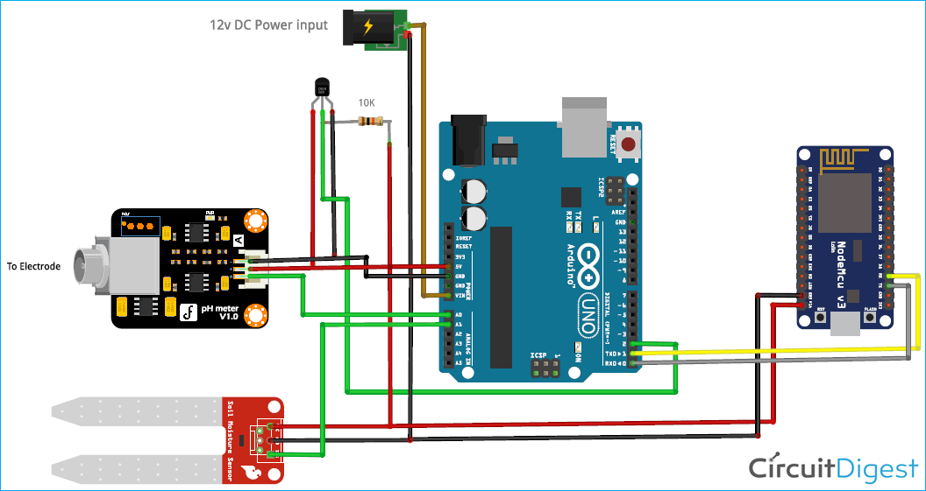
Block Diagram and/or Circuit Diagram

Slide 9
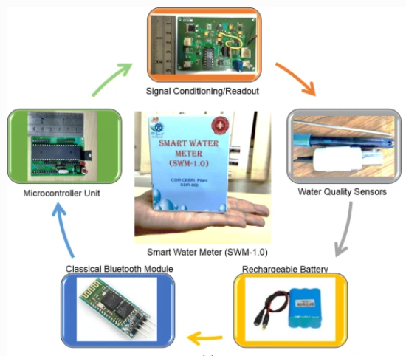
Flow Chart

Slide 10
Effective utilization of the Modern Tool & Cloud
We used INTERNXT cloud platform its allow to access a group of apps adapted for all your devices and you can remotely upload the content.
The cloud keeps updating data collected from the water quality sensors and it is been sent to the mobile app using this internxt platform.
You can store and retrieve the data as when you want .this platform provides reliable customer support.

Slide 11
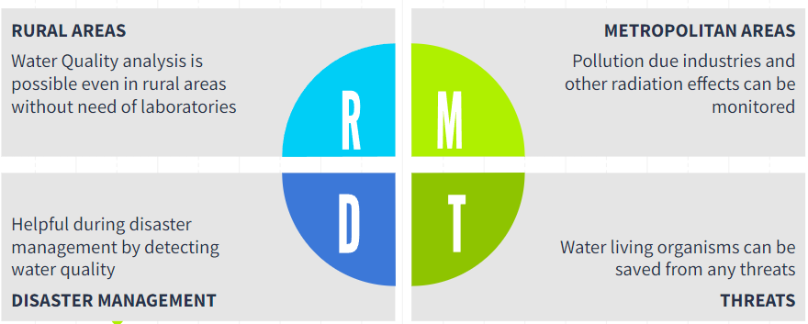
Technology stack & use case

Slide 12
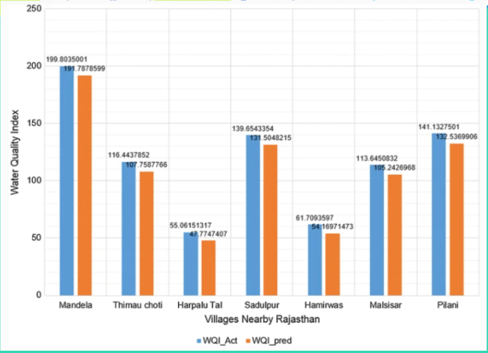
Prototype & Sample Output

Slide 13
Analysis of Results & Discussions
A smart phone based application interface with various advanced features such as location-based data collection, storage on the cloud, interaction with google map for quick judgement, sensor calibration and many more has been introduced. system has been tested for various water quality measurement applications. The overall system is cost effective , portable and easy to use for villagers or any unskilled person.

Slide 14
Cost Benefit Analysis (List of Components / Service Used)
COMPONENTS | PRICES (in Rupees)
1. Micro Controller – Node MCU | 209
2. Bluetooth Module | 700
3. Rechargeable Battery | 700
4. Water Quality Sensor ( TDS ) | 189
5. pH Sensor | 1600
6. Smart Water Meter | 500
Total Price - 3,898 Rupees

Slide 15
References
Applied Membranes Inc. home page ,retrieved from
https://www.appliedmembranes.com/chemical-test-kits-for-testing-water-quality.html
Bai V, Bouwmeester R, Mohan S (2009) Fuzzy logic water quality index and importance of water quality parameters. Air Soil Water Res 2:51–59
HANNA instruments, home page, retrieved from https://hannainst.com/hi3817-water-quality-test-kit.html

